Slide 1

FMFX Flow Dynamics: Unlocking Value & Volume Opportunities
By: Ahmad Mathusin
Date: 28/09/2025
Notes:
AI-generated content may be incorrect. --- This presentation provides an in-depth analysis of FMFX flows, focusing on value and volume metrics. We explore updated observations, market opportunities, and strategic recommendations to optimize corridors and enhance FMFX's market position.

Slide 2



Content
Executive Summary
Strategic Overview of FMFX Flows
Top Remitters (Inflows)
Value versus Volume Analysis
Top Beneficiaries (Outflows)
Value versus Volume Analysis
Network Effects
Geographic and Behavioural Flow Mapping
Enhanced Corridor Opportunities
Top Remitter Deep Dive
Flutterwave as a Remitter
Top Beneficiary Deep Dive
Coinbase as a Beneficiary
Strategic Takeaway
Dual Approach for Market Leadership
Notes:
We'll begin with a strategic overview of FMFX flows, followed by detailed value versus volume analyses of top remitters and beneficiaries. Then, we explore network effects, geographic and behavioral flow mapping, enhanced corridor opportunities, deep dives into key players, and conclude with strategic takeaways.

Slide 3

Executive Summary: Strategic Overview of FMFX Flows
Notes:
This section highlights the contrast between high-value and high-volume corridors, emphasizing a winning strategy that combines revenue generation and customer stickiness. The key takeaway is to adopt a tailored approach for corridor optimization to maximize FMFX's effectiveness.

Slide 4
Contrast Between High-Value and High-Volume Corridors
High-Value Corridors
Generate significant revenue with fewer transactions, focusing on large-value deals.
High-Volume Corridors
Create customer loyalty through frequent transactions with lower per-transaction value.
Strategic Corridor Management
Understanding the trade-offs between value and volume is essential for effective corridor strategy.
Notes:
High-value corridors generate significant revenue but may have lower transaction volumes, while high-volume corridors create customer stickiness through frequent transactions but may have lower per-transaction value. Understanding this contrast is crucial for strategic corridor management.

Slide 5

Winning Strategy: Combining Revenue and Frequency
Balancing Revenue and Frequency
An effective strategy balances high-revenue corridors and those that increase transaction frequency and customer retention.
Sustainable Growth
Combining revenue generation with customer retention fosters sustainable growth in competitive financial ecosystems.
Competitive Advantage in FMFX
This combined approach strengthens market positioning and enhances competitive advantage within the FMFX ecosystem.

Slide 6


Top Remitters (Inflows): Value versus Volume Analysis

Slide 7
Value and Volume of Top Remitters
Leading Value Inflows
Flutterwave Ltd leads value inflows significantly with £680M, followed by Paystack and Interswitch.
Top Transaction Volumes
Flutterwave also leads transaction volumes with 473, followed by M-Pesa (261) and Paystack (234)

Slide 8
Value and Volume of Top Remitters
Observations
Large African PSPs dominate inflows, split between Flutterwave with high-value/high-frequency and M-Pesa with low-value/high-frequency.

Slide 9
Top Beneficiaries (Outflows): Value versus Volume Analysis

Slide 10
Value and Volume of Top Beneficiaries
Leading Value Outflows
Bitstamp leads value outflows significantly with almost 700M, followed by Kraken (439M) and Coinbase (212M)
Top Transaction Volumes
Coinbase leads transaction volumes with 617 transactions, followed by Bitstamp (533) and Kraken (436)

Slide 11
Value and Volume of Top Beneficiaries
Observations
Outflows heavily concentrated to crypto exchanges
Bitstamp/Kraken/Bitpanda: chunky, large-ticket flows.
Coinbase: very active, smaller-ticket flows.
Paxos: sits between, both in £ and tx count.

Slide 12
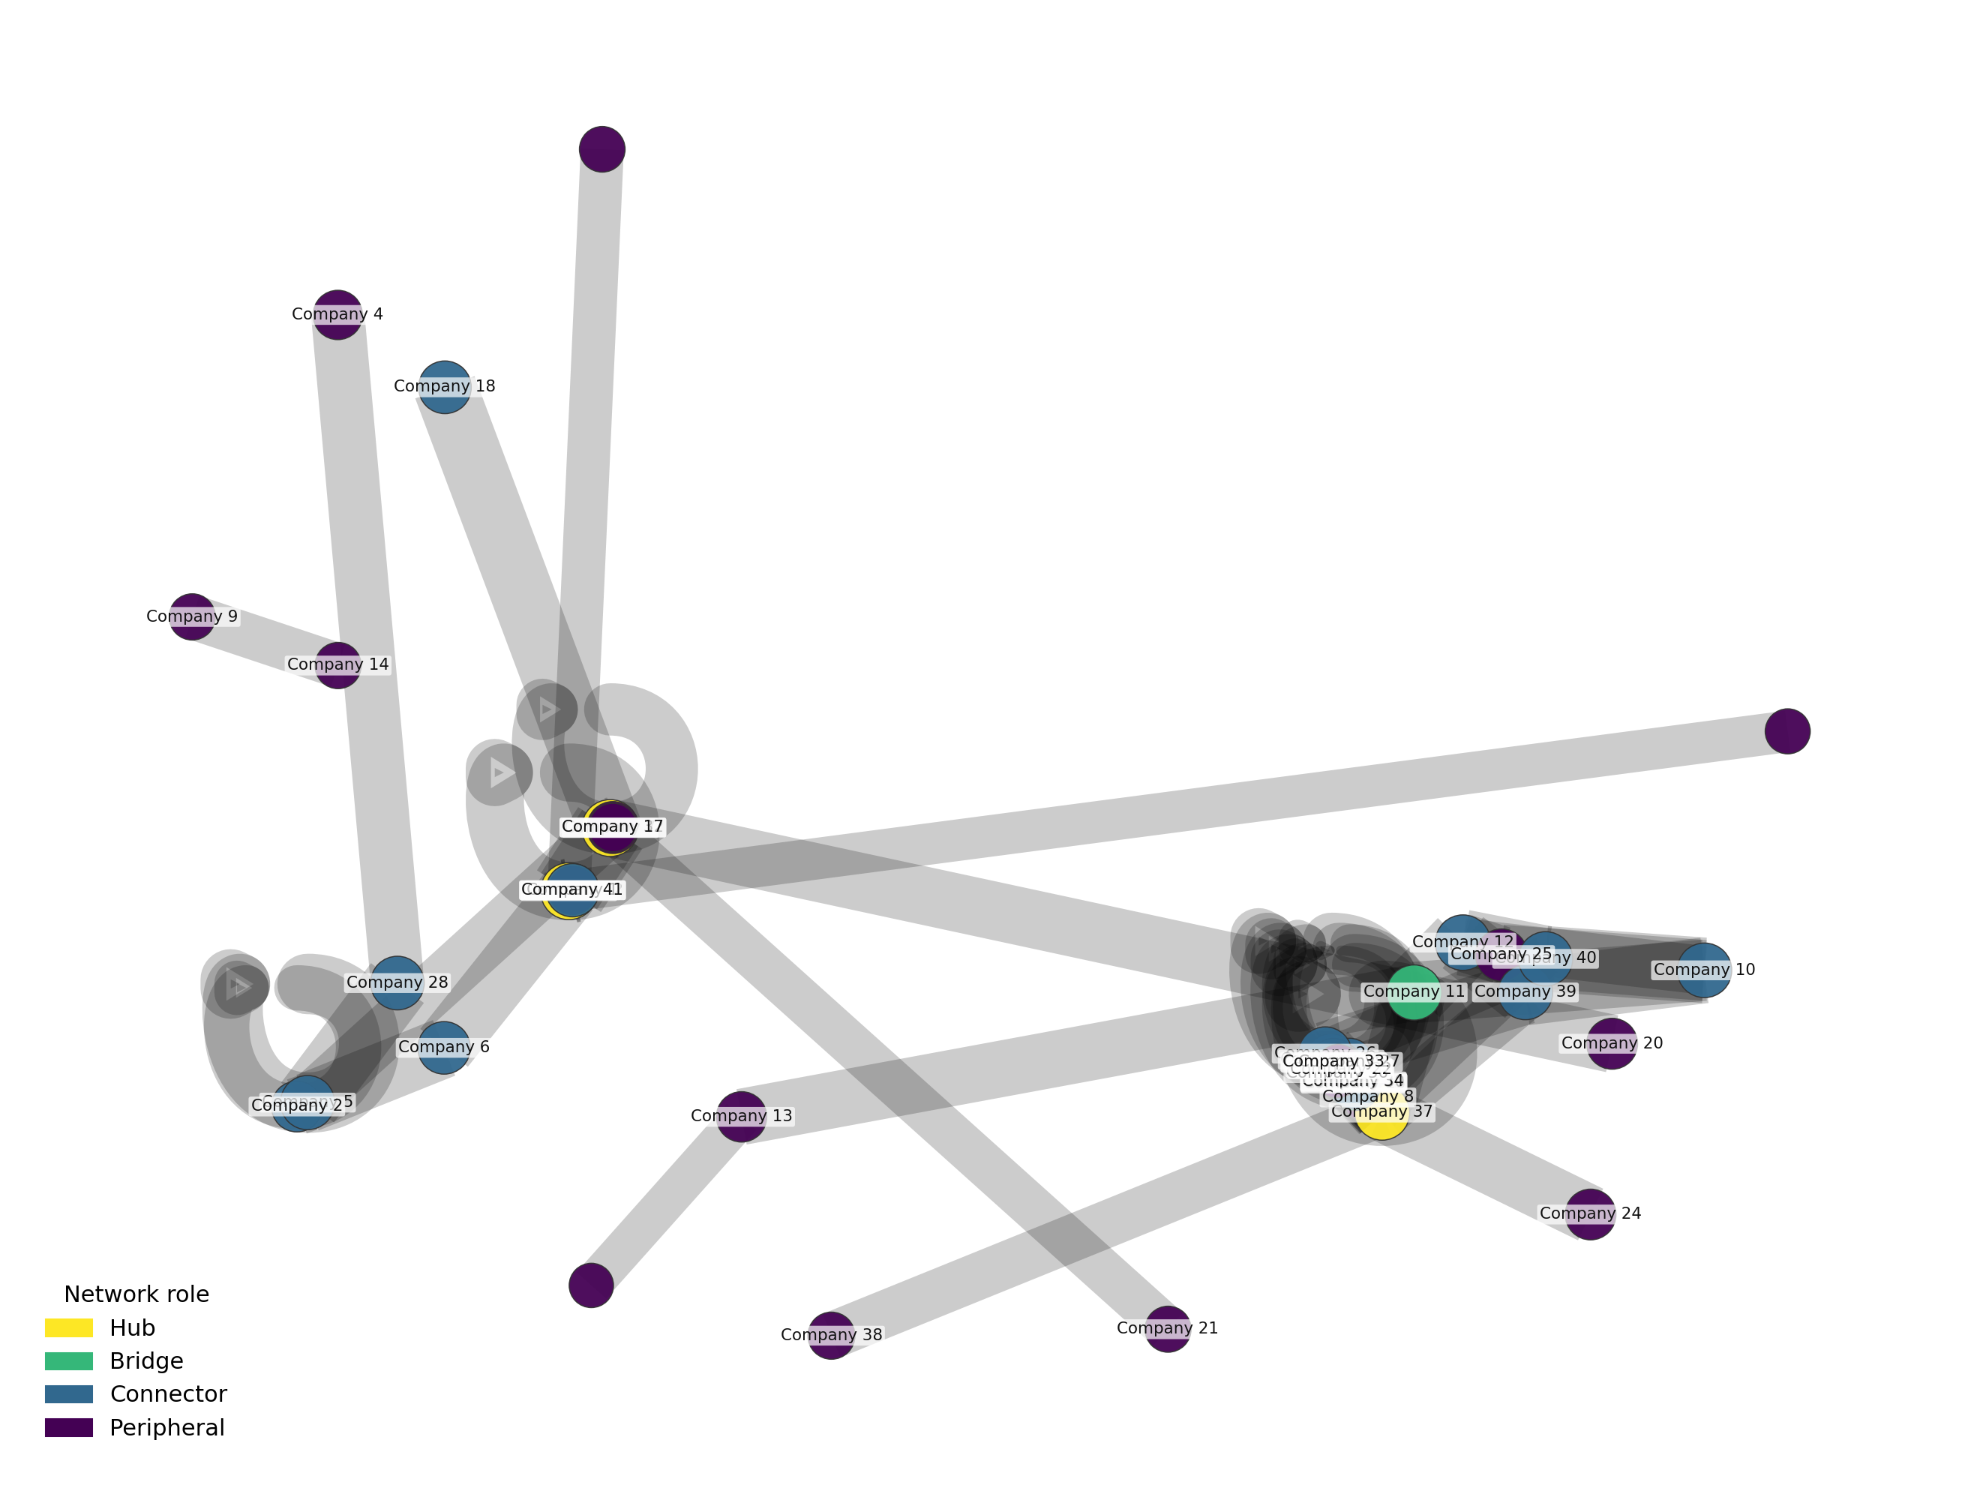
FMFX Network Effects
Network plot shows hubs and spokes – few clients act as hubs, many remain peripheral.
Hubs:
Drive majority of flows - key corridors visible with thick edges (high-value/high-volume).
Current network effect:
Primarily hub-and-spoke. An opportunity to increase density by linking peripheral clients.
Strategic takeaway:
Strengthen hubs, expand spokes, and prioritise top corridors to maximise network effect.

Slide 13
Geographic and Behavioural Flow Mapping
Notes:
This section highlights the contrast between high-value and high-volume corridors, emphasizing a winning strategy that combines revenue generation and customer stickiness. The key takeaway is to adopt a tailored approach for corridor optimization to maximize FMFX's effectiveness.

Slide 14


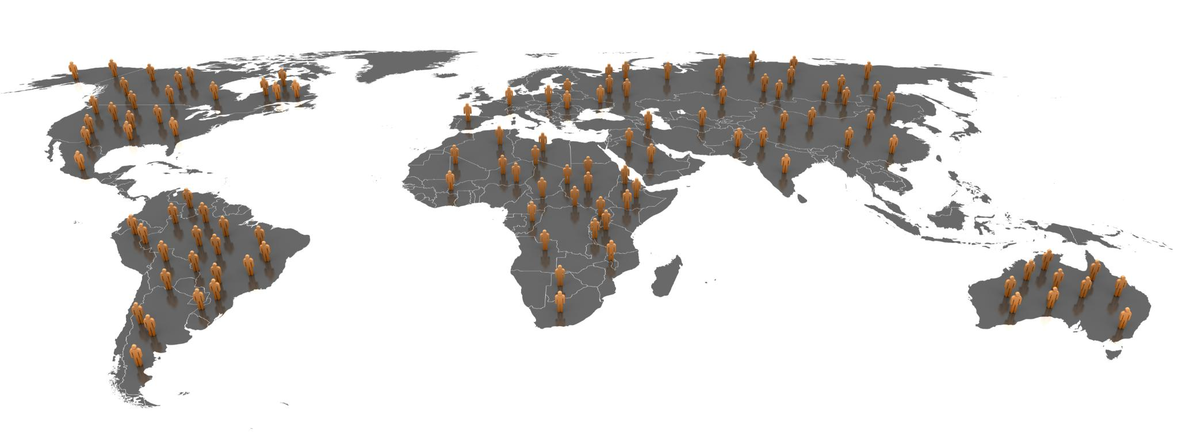
Mapping Inflows
Primary Source Countries
Great Britain, the US, and Ireland are the main source countries for financial inflows to Africa.
Destination: African PSPs
Inflows are directed towards African Payment Service Providers, highlighting key financial corridors.
Market Focus for FMFX
These inflow patterns indicate strategic markets and corridors for FMFX’s operational focus and growth.
Notes:
Inflows predominantly originate from Great Britain, the US, and Ireland, directed towards African Payment Service Providers, indicating key markets and corridors for FMFX focus.

Slide 15
Enhanced Corridor Opportunities
Notes:
This section highlights the contrast between high-value and high-volume corridors, emphasizing a winning strategy that combines revenue generation and customer stickiness. The key takeaway is to adopt a tailored approach for corridor optimization to maximize FMFX's effectiveness.

Slide 16


Opportunities: High Value vs High Traffic
High Value
High Traffic
Flutterwave and Bitstamp Integration
Flutterwave-Bitstamp high value corridor offers valuable foreign exchange hedging opportunities to mitigate currency risks effectively.
Margin Management Improvement
Using hedging strategies through this corridor can enhance margin management and optimise financial performance for FMFX.
Risk Exposure Reduction
Effective hedging reduces exposure risks, helping FMFX maintain stability in volatile currency markets.
Flutterwave and Coinbase Integration
Flutterwave–Coinbase high traffic corridor enables batching, auto-netting, and API connectivity to streamline settlement and reduce costs.
Process Automation Benefits
High transaction volumes create scope for straight-through processing (STP), improving accuracy and freeing client resources.
Network Effect Advantage
Consolidating frequent flows across shared counterparties enhances FMFX’s visibility, customer retention, and ability to scale corridors

Slide 17
Deep Dive: Flutterwave as a Remitter
Notes:
This section highlights the contrast between high-value and high-volume corridors, emphasizing a winning strategy that combines revenue generation and customer stickiness. The key takeaway is to adopt a tailored approach for corridor optimization to maximize FMFX's effectiveness.

Slide 18



Company Profile
African Origins
Flutterwave was founded in Africa, emphasizing its roots in the continent's growing tech ecosystem.
Digital Payments Platform
The company operates a robust digital payments platform enabling seamless transactions across borders.
Strong Funding
Flutterwave has secured strong funding rounds supporting its rapid growth and market expansion.
Leading Remittance Provider
The company is a leading remitter in high-value corridors, connecting global payments efficiently.
Africa’s Digital Payments Market Outlook
Market Growth Projection
The digital payments market in Africa is expected to reach $1.5 trillion by 2030, showing rapid expansion.
Growth Opportunities
This growth creates significant opportunities for fintech companies to expand services and customer base.
Notes:
Flutterwave, founded in Africa, operates a robust digital payments platform with strong funding and valuation, positioning it as a leading remitter in high-value corridors.

Slide 19
Deep Dive: Coinbase as a Beneficiary
Notes:
This section highlights the contrast between high-value and high-volume corridors, emphasizing a winning strategy that combines revenue generation and customer stickiness. The key takeaway is to adopt a tailored approach for corridor optimization to maximize FMFX's effectiveness.

Slide 20

Company Profile
Strong Revenue Performance
Demonstrates robust revenue growth, reflecting market success and financial stability.
EU Passporting Rights
Holding EU passporting rights allows seamless provision of services across European countries under unified regulation.
MiCA Licensing
Ensures adherence to European crypto asset market standards and enhances credibility.
Leading Remittance Provider
Leading remitter in high-value corridors, connecting global payments efficiently.
Global Crypto Exchange Market Growth Projections
Market Expansion Drivers
Increasing adoption and clearer regulations are key factors driving the expansion of the global crypto exchange market.
Impact on Exchange Strategies
Exchanges like Coinbase and FMFX are benefiting from corridor strategies amid market growth and regulatory clarity.
Notes:
Coinbase boasts strong revenues, holds EU passporting rights, and is licensed under MiCA regulations, enhancing its credibility and operational scope in Europe.

Slide 21
Strategic Takeaway: Dual Approach for Market Leadership

Slide 22
Locking in High-Value £ Corridors
Prioritize High-Value Corridors
Focusing on corridors with significant monetary value strengthens FMFX’s revenue and market position.
Enhance Revenue Base
Increased revenue from key corridors enables strategic investments and business growth.
Invest in Technology and Service
Revenue gains support advancements in technology and improvements in service quality.
Notes:
Prioritizing corridors with significant monetary value enhances FMFX’s revenue base, enabling investment in technology and service quality improvements.

Slide 23
Capturing High-Volume Corridors for Strong Retention
Frequent Transactions
Encouraging frequent transactions in key corridors strengthens customer engagement and loyalty.
Customer Retention
High-volume corridors enable greater customer retention through repeated interactions.
Cross-Selling Opportunities
Increased transactions open opportunities for cross-selling to maximize revenue.
Notes:
Fostering frequent transactions in high-volume corridors increases customer retention and cross-selling opportunities, supporting long-term growth.

Slide 24

Actionable Recommendations for Growth
Enhance Treasury Automation
Improving treasury management through automation increases efficiency and accuracy in financial operations.
Develop Shared Networks
Creating shared counterparty networks fosters collaboration and expands FMFX reach across markets.
Tailor Corridor Strategies
Customizing strategies based on corridor-specific dynamics helps target growth opportunities effectively.
Notes:
Recommendations include enhancing treasury and API automation, developing shared counterparty networks, and tailoring strategies to corridor-specific dynamics to drive FMFX expansion.

Slide 25
Conclusion
Balancing Value and Volume
Success depends on effectively balancing value and volume flows to optimize business performance.
Leveraging Network Effects
Utilizing network effects amplifies growth and strengthens market presence for FMFX.
Tailored Corridor Strategies
Adopting customized strategies for key corridors enhances competitive advantage.
Capitalizing Market Opportunities
Implementing insights enables FMFX to seize emerging market opportunities and sustain growth.
Notes:
FMFX's success hinges on balancing value and volume flows, leveraging network effects, and adopting tailored strategies for key corridors. Implementing these insights positions FMFX to capitalize on emerging market opportunities and sustain competitive advantage.

